Slide 1
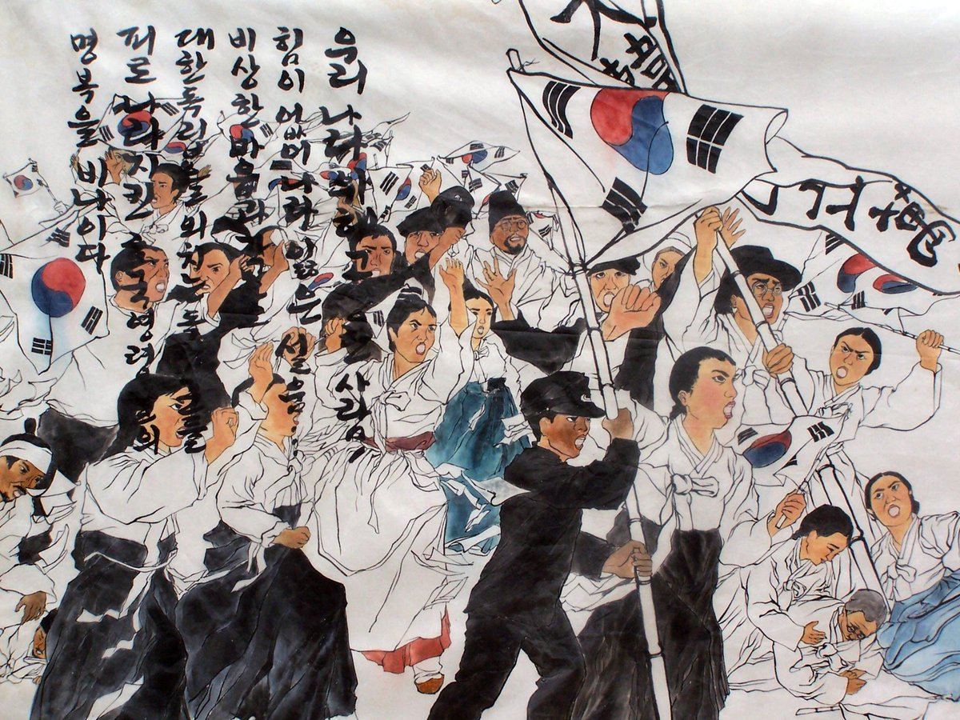

3·1운동
3·1운동이 일어난 시대적 배경
Notes:
3·1 운동, The March 1st Movement
The history of The March 1st Movement

Slide 2
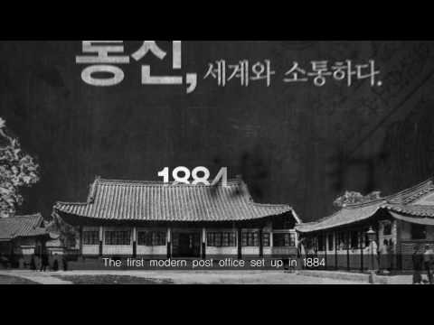
달라지는 세계, 달라지는 조선
Notes:
This is a video from the National Palace Museum. In the late 19th century, when the world was changing rapidly, so was 조선. You can see 조선’s first acceptance of Western culture. Let’s take a look at when new technology such as streetcars, electricity, electric lamps, and the first modern post office were introduced to 조선.

Slide 3
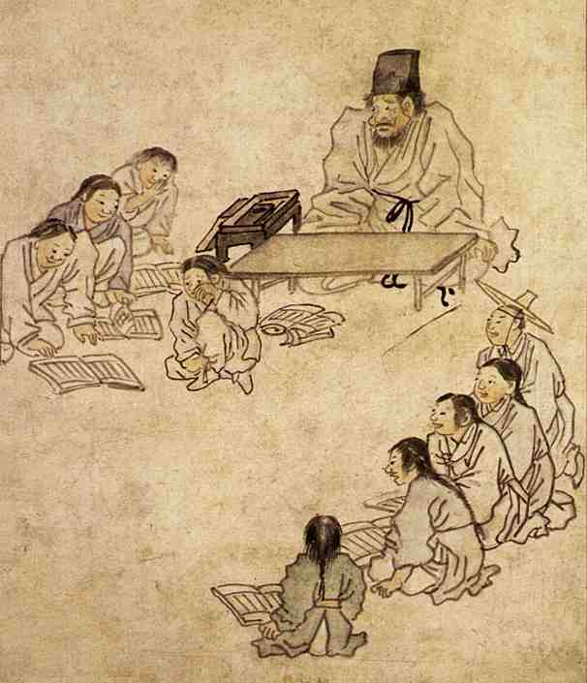
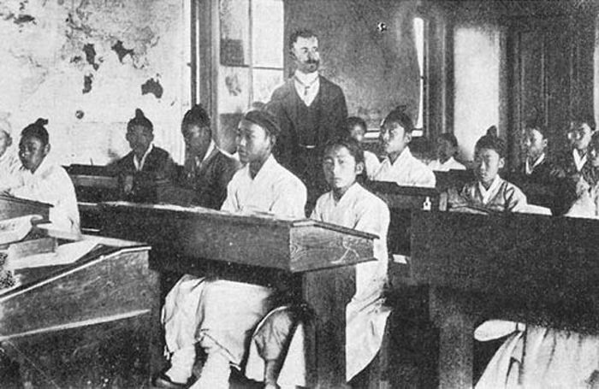
새로운 교육의 시작
왼쪽 그림과 오른쪽 사진의 다른점 생각하기
Notes:
Look at these two pictures.
<click> (글씨 나온 후 자동 재생) Can you find any differences?... In both pictures, the students’ hair and clothes are the same. But, in the picture on the left, both the teacher and the students are sitting on the floor. In the photo on the right, students are studying at desks and chairs. And, there is a world map on the wall. Also, look at the teacher in the photo. He is a westerner. This is the first modern school established by 조선, 육영공원.

Slide 4
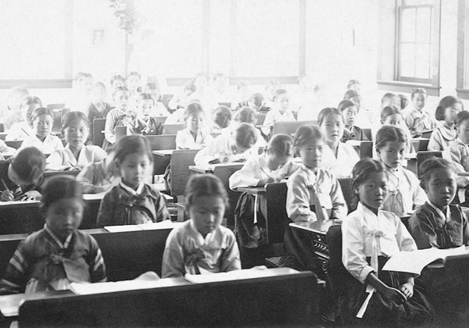
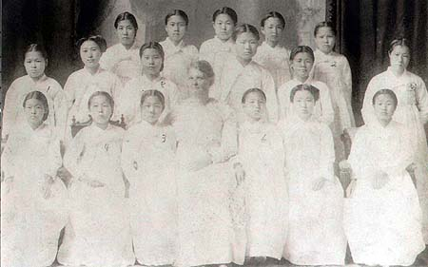
이화학당 학생들과 선생님의 모습
Notes:
Look at the pictures of the girls studying.
<click> (글씨 나온 후 자동 재생) They are studying at 이화학당 which was the first school for girls in 조선. The photo on the right is the graduation photo of the girls at 이화학당. Can you see the foreign missionary who was also the principal, in the middle of the photo? The student in the far right of the back row is 유관순.

Slide 5
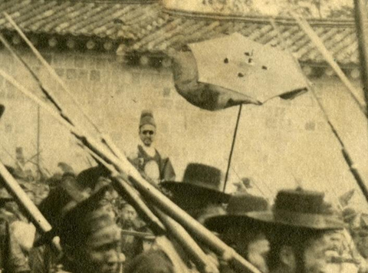
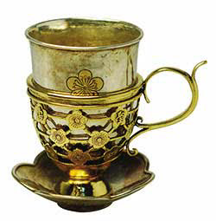
서양 문물의 소개
선글라스
커피잔
Notes:
Look at these pictures.
<click> (글씨와 동그라미 나온 후 자동 재생) 고종 is wearing 조선 clothing but with sunglasses. You can see that many Western items had been introduced at the time.
<click> (글씨 나온 후 자동 재생) This is the coffee cup that 고종 used. 고종 liked coffee. Coffee was introduced in 조선 at the time of the 19th century. It was called 가배 or 양탕국 meaning Western soup.

Slide 6
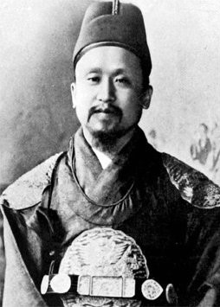
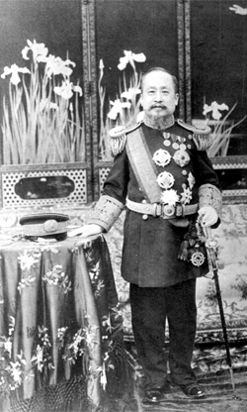
단발령 (Short Hair Act Order)
서양옷과
짧은 머리의 고종황제
Notes:
<click> (화살표와 글씨 나온 후 자동 재생) Now, look at this picture. On the left is 고종 with 조선 clothes and 조선 hair. And on the right is 고종 with Western clothes and short hair. On December 30, 1895, the Short Hair Act Order was issued, and this is 고종’s short hair cut.

Slide 7
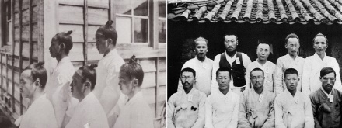
단발령 (Short Hair Act Order)
상투(Sangtu) 머리
짧은 머리
Notes:
In 조선, men also grew their hair and had a topknot hairstyle.
But, after the Short Hair Act Order, 단발령 was issued, they started to wear short hairstyles.

Slide 8
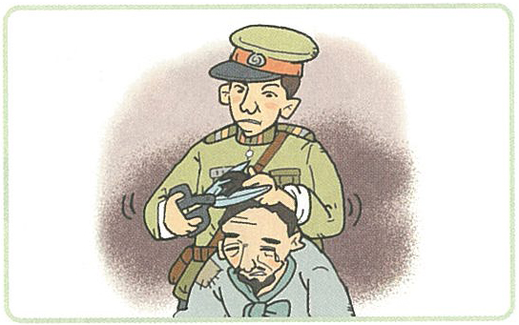
짧은 머리를 반대하던 사람들
“신체발부수지부모”
나의 몸은
부모님께서
주신 것이므로
소중히
여겨야 한다
Notes:
Neo-Confucianism was the main philosophy of 조선. It was considered that it was a filial duty to cherish one’s body, from head to toe, which parents had given. So, people were reluctant to cut their hair in a Wester style. It was against the thoughts and culture that they had been keeping for a long time. Also, because they were forced, there was backlash. Can you see the man crying while cutting off his topknot?

Slide 9
구한말 시대 (1891-1910)
빠르게 변하는 세계 정세
외세의 침입
근대화의 요구
조선 말기
Late Joseon Period
1871-1897
대한제국
Great Korean Empire
1897-1910
한국 강제 병합
Japan–Korea Annexation Period
1910-1945
Notes:
‘구한말 시대’ is from the late 조선 period, specifically after 고종’s ascent to the throne to when 대한제국 was forcibly annexed to Japan as known as the Japan-Korean Annexation.
<click> (화살표와 글씨 나온 후 자동 재생) At this time, the world changed rapidly, foreign invasions occurred, and Koreans demanded a modern civilization.

Slide 10
쇄국과 개방사이 조선의 선택
쇄국
개방
Closed Country
Foreign Policy
Opening-up
Notes:
Korea was split into two groups, people who believed opening up the country would be more beneficial and people who believed the Closed Country Foreign Policy, a policy of seclusion, was the only way to protect Korea.

Slide 11
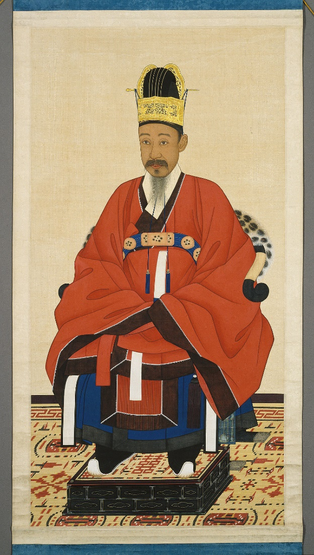
쇄국정책
(Closed Country Foreign Policy)
서양과 교역(Trading)이나 문화 교류(Cultural Exchange)를 하지 않는 것
중국과의 교역은 계속 함
고종의 아버지 흥선대원군의 정책
강화도 조약으로 개방(Opening-up)을 하게 됨
흥선대원군
Notes:
조선 refused to trade with the West, thinking that Japan was the same as the West because it opened up to accept Western culture during the Meiji Restoration. Korea also put restrictions on trade with Japan. In the meantime, Korea continued to trade with China, 청.
고종 became the king of 조선 at a young age, and his father, 흥선대원군, enforced a policy of seclusion as regent. But after that, the 강화 Treaty opened the doors of 조선.

Slide 12
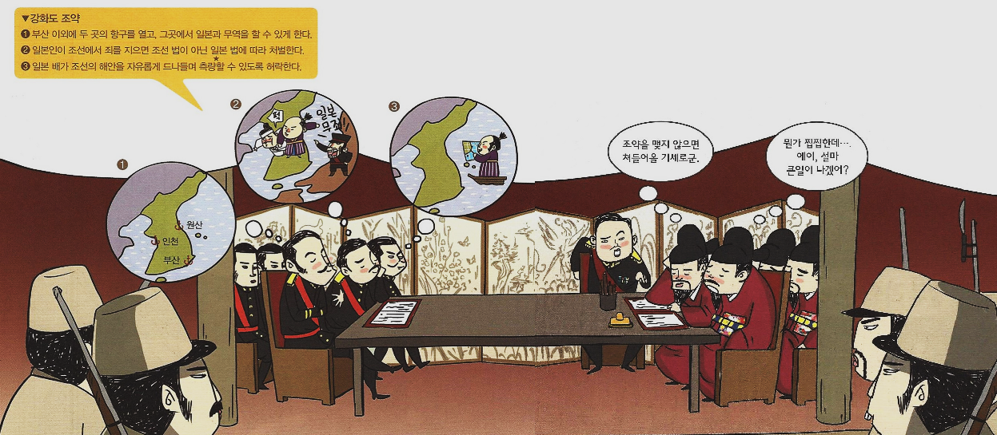
강화도 조약 (Japan–Korea Treaty of 1876)
개방의 시작
Notes:
After the Japanese gunboat ‘Unyo’ incident, the 강화 Treaty, also known as the Japan Korean Treaty of 1876, was signed. Looking at the contents of this treaty, it was unfair for 조선. Ports that were convenient for Japan were opened and if a Japanese citizen committed crime in 조선, they would get punished according to the laws of Japan, not the laws of 조선. Also, the treaty allowed Japanese ships to freely navigate the seas of 조선 to map out.
<click> (글씨 나온 후 자동 재생) This was the start of an unfair opening of 조선’s doors.

Slide 13
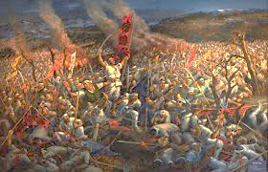

동학 농민 운동 (Donghak Peasant Revolution)
정치·사회 개혁(Reformation)
외세(Foreign Power)를 물리치려 함
민중운동(Movement of people)
관군과 일본에 의해 진압
Notes:
The 동학 Peasant Movement was a civilian movement that took place to reform the political and social problems of 조선 from the inside and defeat foreign powers. Unfortunately, the 조선 requested help from China, 청 and the soldiers came to 조선, and in response, Japan also sent soldiers to 조선. Eventually, it was repressed by the government and Japan. And as a result of this 동학 Peasant Movement, Japan’s invasion of the Korean Peninsula began. This event also triggered the breakdown of the balance of power on the Korean Peninsula.

Slide 14
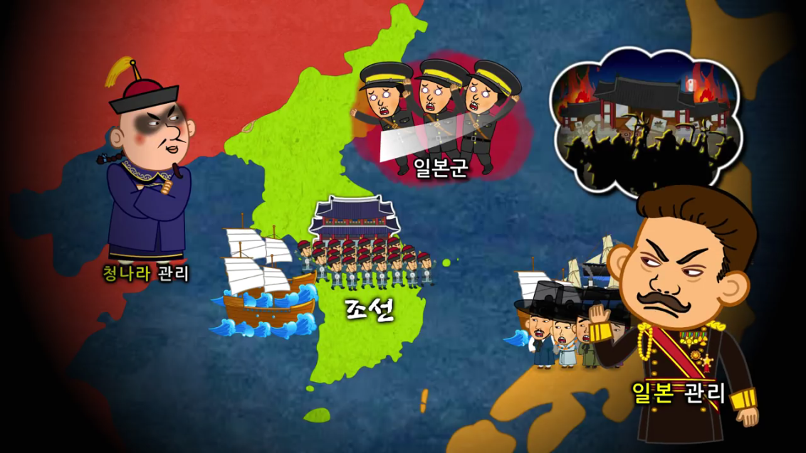
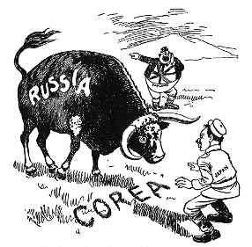
청일전쟁 1894-1895
(Sino-Japanese War)
러일전쟁 1904-1905
(Russo-Japanese War)
Notes:
<click> (글씨 나온 후 자동 재생) After the 동학 Peasant Movement, the Sino-Japanese War and the Russo-Japanese War broke out in the land of 조선. Both wars were won by Japan and this gave Japan the right of control.

Slide 15
을사늑약 (Japan-Korea Treaty, 1905
/ a.k.a. Eulsa Unwilling Treaty)
외국에 있는 일본의 대표자 또는 영사가 외국에 있는 한국 사람들을 보호한다. (한국 공사관의 폐쇄)
한국 정부는 일본 정부의 중개없이 다른 나라와 조약을 맺을 수 없다.
Notes:
After the Sino-Japanese War and the Russo-Japanese War, Japan had more influence and interferences with Korea. In 1905, through the Japan-Korea Treaty, known as 을사 Unwilling Treaty, the diplomatic rights of Korea were taken by Japan. This became the starting point of the merge with Japan. It was made without 고종’s permission. The content of the treaty was that Japanese consuls would protect the Korean people in other countries and would close the legation of 대한제국. Korea could not make treaties with other countries without the approval of Japan.

Slide 16
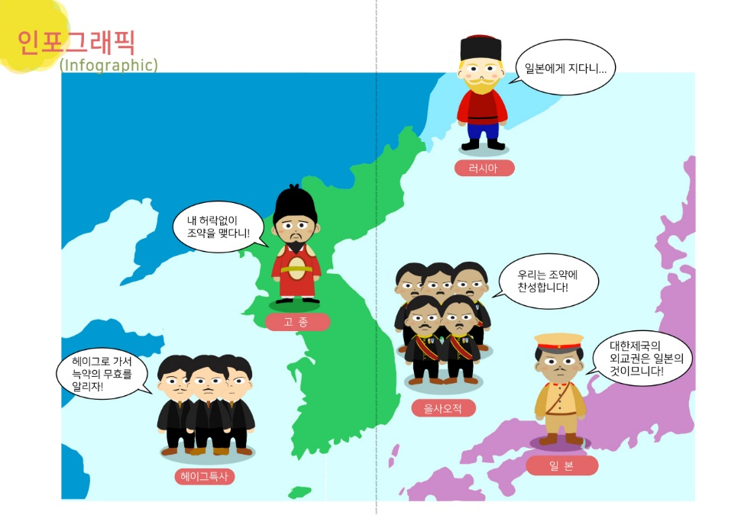
을사늑약 이후…
Notes:
This picture shows Korea after the Japan-Korea Treaty of 1905. 고종 sent a special envoy to Hague to inform that the treaty was invalid, but it failed to achieve its purpose. Even within Korea, some officials took the lead to support Japan and Japan tried to acquire Korea.

Slide 17
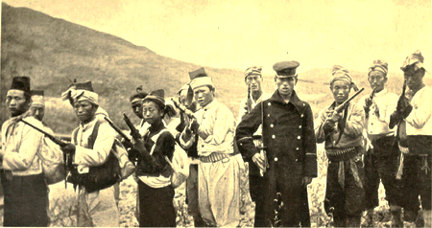
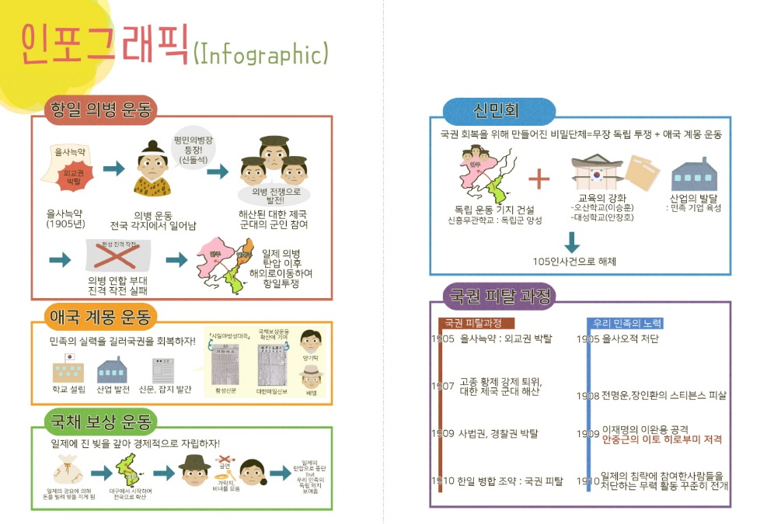
의병 (Righteous Army)
Notes:
The Righteous Army took place in various regions of Korea as many people joined. The Righteous Army rose to fight for the independence of Korea. However, since they were not a formal army, they did not have many weapons nor proper training. This photo of the Righteous Army shows people from all classes and all ages participating.

Slide 18
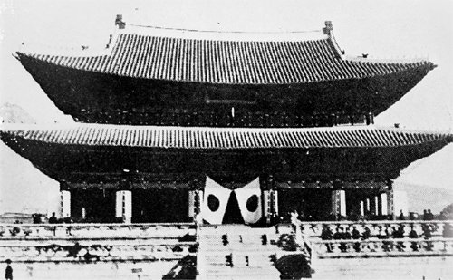
한국 강제 병합 (Japan-Korea Annexation)
일본 국기가 걸린 이곳은 어디일까요?
Notes:
Thus, on August 29, 1910, Korea lost its national power to Japan.
<click> (글씨 나온 후 자동 재생) Can you see where the Japanese flag was hung? It was placed in the main palace of 조선, 경복궁.

Slide 19
일제의 무단 통치 (Japanese Military Ruling)
일본이 한국을 통치하기 위해 조선총독부(Government General of Joseon)를 만들었다.
일본의 헌병(Military Police)이 중심이 되어 한국을 통치했다.
언론(Press), 표현(Speech), 집회(Association), 결사(Assembly)의 자유가 제한되었다.
Notes:
After the Japan-Korea Annexation, Japan established 조선총독부, the Government General of 조선. The Japanese military police became the center of rule in Korea. And Japan started to restrict freedom of press, speech, association, and assembly.

Slide 20
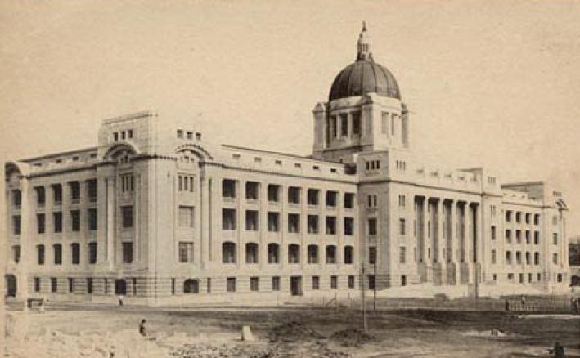
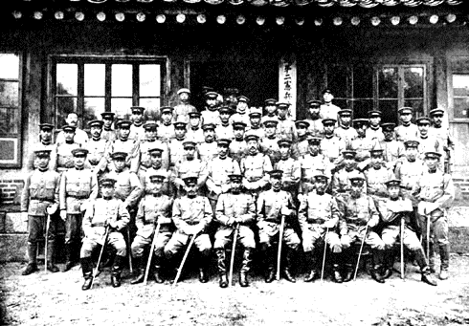
일본 헌병들
(Military Polices)
조선총독부 건물
(Government General of Joseon)
Notes:
<click> (글씨 나온 후 자동 재생) This is the building of 조선총독부, the Government General of 조선. It was built completely covering 경복궁, the main palace of 조선
<click> (글씨 나온 후 자동 재생) These are Japanese military police who came to Korea.

Slide 21
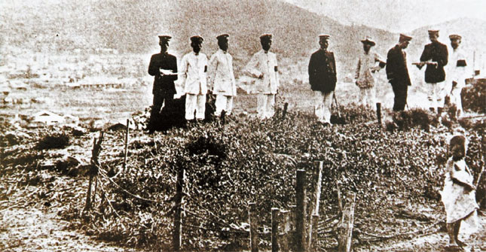
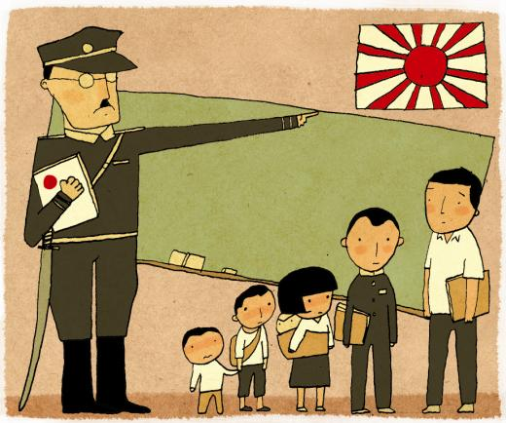
칼을 차고 학생들을 가르치는 선생님
토지 측량을 하면서 한국 땅의 40%를 빼앗음
Notes:
<click> (글씨 나온 후 자동 재생) Japan took 40% of Korea’s land during a land survey project.
<click> (글씨 나온 후 자동 재생) This is a picture of a Japanese teacher teaching children with a sword on his hip.

Slide 22
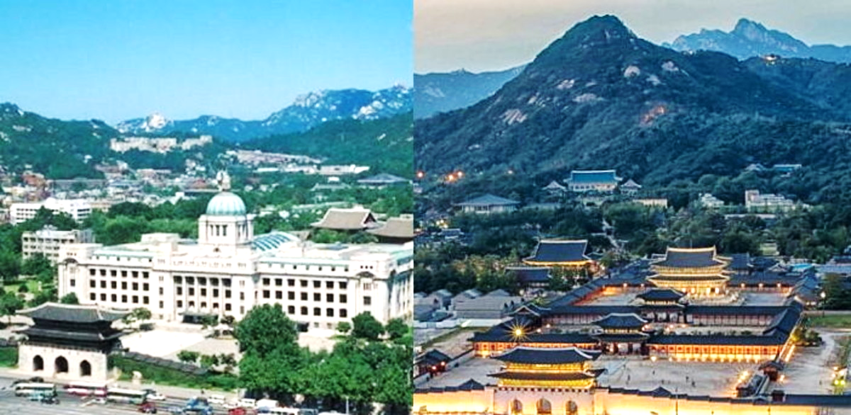
조선총독부는 어디로 갔을까?
1910-1995
1995년 8월 15일 - 현재
1995년 철거되어 현재 일부가 독립기념관에 있음
Notes:
<click> (글씨 나온 후 자동 재생) The photo on the left is the building of 조선총독부, the Government General of 조선.
<click>The photo on the right is after it was demolished. The building completely covered 경복궁.
<click> (글씨 나온 후 자동 재생) After the building of the Government General of 조선 was demolished in 1995, some of the pieces are kept in 독립기념관, the Independence Hall.

Slide 23
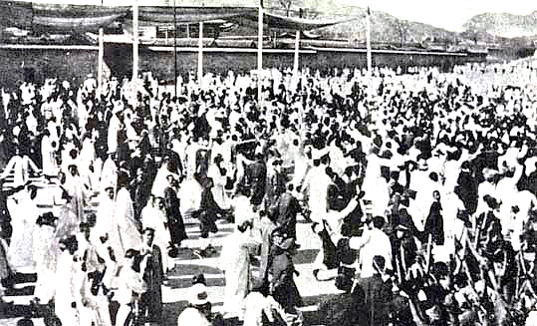
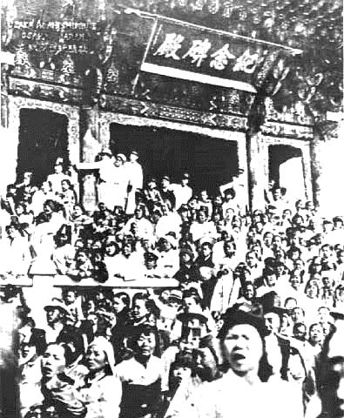
항일 독립운동 (Korean Independence Movement)
3·1 운동
거리에서 만세를 외치는 사람들
3·1 운동
서울 탑골공원
Notes:
After Japan invaded Korea, the people of Korea demanded independence and they started the independence movement.
<click> (글씨 나온 후 자동 재생) This is a picture of people shouting ‘대한독립 만세’ meaning ‘Long live Korea’s Independence’ on March 1, 1919.

Slide 24
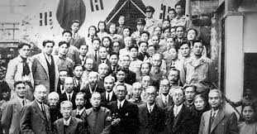
항일 독립운동 (Korean Independence Movement)
대한민국
임시정부
Provisional Government of the Republic of Korea
Notes:
This is a picture of people who worked for the 대한민국 임시정부, the Provisional Government of the Republic of Korea.

Slide 25
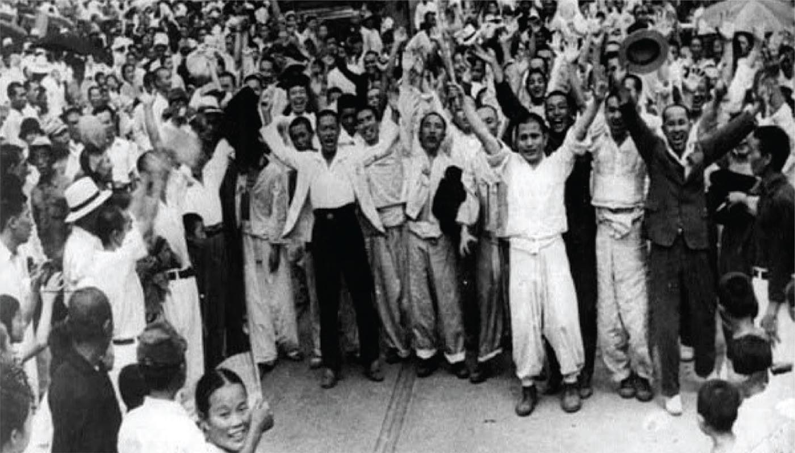
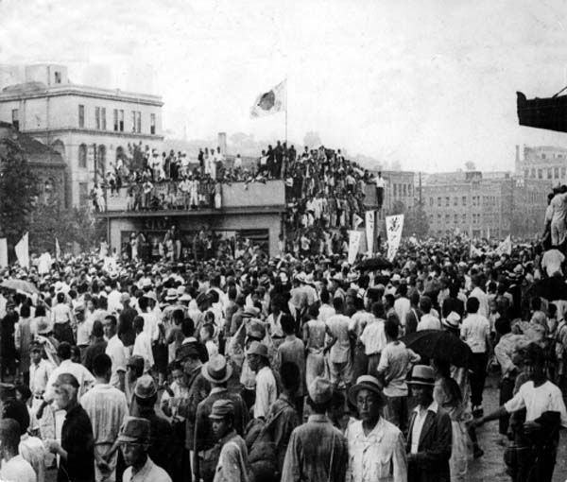
광복 (1945년 8월 15일)
Notes:
Finally, on August 15, 1945, Korea declared its independence.

Slide 26
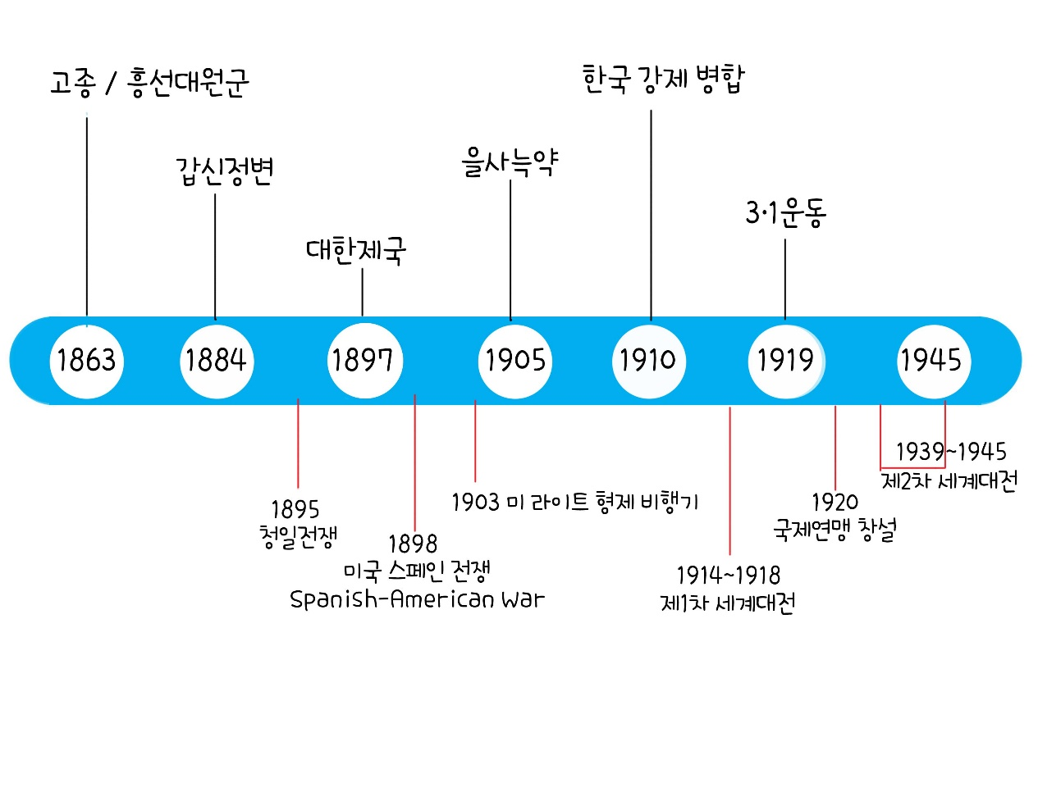
Notes:
This timeline shows events starting from the crown of 고종 to 1945, when liberation took place. World history events such as the Sino-Japanese War in 1895, the US-Spanish War in 1898, the American Wright brothers’ plane in 1903, WWI in 1914-1918, the creation of the League of Nations in 1920, and WWII in 1939 also occurred during this time.

Slide 27
자료 출처
글 황은희, 그림 송진욱 교과서 속 역사 이야기, 그림으로 보는 한국사: 5. 조선의 개항부터 현대까지, 계림사 (2013)
참쌤스쿨: https://chamssaem.tistory.com/
석화정 풍자화로 보는 러일전쟁, 지식산업사 (2007)
조선을 이어 대한제국으로: https://www.youtube.com/watch?v=OEYRLGgxDyw

